Slide 1


HVS​
Concept of Energy Management

Slide 2

Contents
Consumption calculate
Power limit

Slide 3
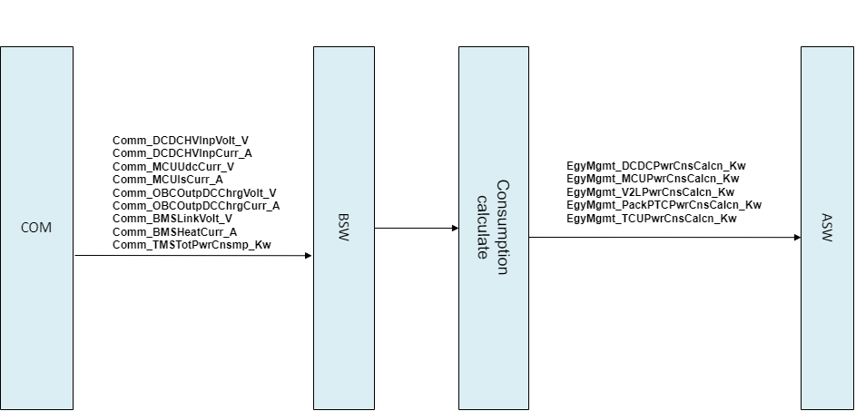
Consumption calculate
diagnosis

Slide 4
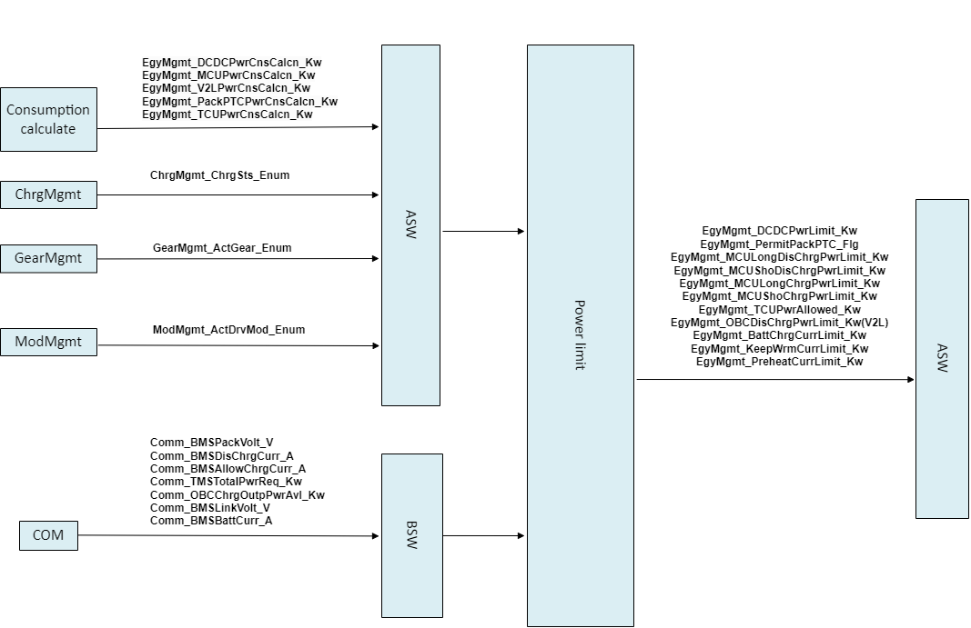
Power limit
selectiondiagnosis

Slide 5
Power limit
selectiondiagnosis
Power limit
Functional logic description
a、Determine the power or current limitations of motor long and short charging and discharging, battery charging and discharging, DCDC, PackPTC, TCU, and OBC (V2L) based on charging, gear, and driving mode status.
b、Among them, the power limitation of motor charging and discharging needs to be calculated based on the algorithm of power closed-loop protection function.

Slide 6
Backup

